Slide 1
CSSE 332 Operating System
Introduction to OS

Slide 2
Agenda
Course Overview
Intro to OS:
Motivation
Topics

Slide 3
Materials
Syllabus: https://rhit-csse.github.io/csse332/syllabus/
Textbook is optional:
Operating System Concepts, 9th Edition, Abraham Silberschatz, Greg Gagne, and Peter B. Galvin, Wiley, 2012.
(Highly Recommended) A free open-source textbook: Operating Systems: Three Easy Pieces

Slide 4
Weekly Schedule
3 lectures + 1 lab (occasionally 4 lectures)
Hands-on activities in each if not all lectures (submission required)
2 coding assignments due (usually) on Monday and Thursday
Bookmark this website:
https://rhit-csse.github.io/csse332/schedule.html

Slide 5
Coding Assignments
Basic:
About 9 in total
Need to be done individually, except for the BareMetalOS project
Advanced:
About 6 in total
can be done in groups of 2, or individually.

Slide 6
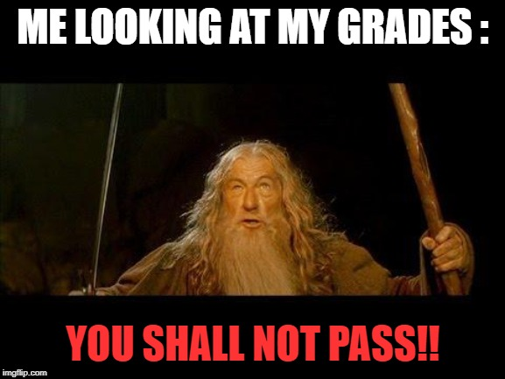
Coding Skill Tests (a.k.a., Exams)
2 in total
Completely online
You must pass each skill exam (usually 65% or better) to pass the course.
Each exam will have a makeup.
However, if you fail both the exam and the makeup, you fail the course.

Slide 7
Grade
Item | Weight
Assignments/Labs | 55%
ADVANCED Assignments | 15%
Exams | 30%

Slide 8

Do not create public repo for your solutions
It is considered an academic misconduct to publish your solutions to the problems in this repo in a public way (e.g., by forking this repo and pushing solutions to Github).

Slide 9
Intro to OS: Motivation (Why OS) I
Problem 1:
How to run two programs on one machine?
Analogy: How do two chefs cook two dishes using the same set of kitchenware “simultaneously”?
Concurrency: Multi-process/threading

Slide 10
Intro to OS: Motivation (Why OS) II
Problem 2:
How to store a file in a computer?
Analogy: Given many words (as characters), how to store them in a way that individual word can be retrieved separately?
Persistence: FileSystem

Slide 11
Intro to OS: Motivation (Why OS) III
Problem 3:
How the memory (the big array) can be shared among many processes?
Analogy: How to run a sneaky car rental company?
In this company, the greedy customers tend to ask too many cars but they don’t actually use all of the cars all the time when they hold them.
So as a crafty company, you can take some of their cars back secretly to give to other customers in need, then return the cars later.
Virtualization: Memory Management

Slide 12
Reminder
Userspace Threads due tonight
Feel free to playfully start ADVANCED Userspace Threads With Preemption

